Slide 1
Conceptualization and Application
of Deep Learning and
Applied Statistics for
Flight Plan Recommendation
2d Lt Nicholas C. Forrest
18 March 2020
Advisor: Dr. Raymond R. Hill
Readers: Lt Col Jason R. Anderson, Ph.D.
Capt Phillip R. Jenkins, Ph.D.

Slide 2
Overview
Background and Introduction
Research Objectives
Data and Recommendations
Exploratory Data Analysis
Student Performance Metrics
Modeling Approach
Model Results and Analysis
Contributions
Future Work
Prototype of Algorithm
Notes:
Background and Motivation for Research
Research Objectives
Data Exploration and Analysis
Modelling Approaches
Conclude with research contributions and the way forward.
And then I have a quick example of the working prototype recommender system.

Slide 3
Background
Current pilot shortage of roughly 2,000 pilots (~10%), and 1,000 fighter pilots (~27%)
Pilot production stems from the ability to efficiently and effectively train pilots
Current pipeline takes ~12 months to complete, excluding casual status time
Increasing pilot production via the traditional pilot training pipeline requires an increase in funding, equipment, and manpower resources that are currently unobtainable.
Air Force must move past traditional methods and implement virtual and constructive training in order to meet current and future force readiness demands
Gamification in training → Pilot Training Next represents the Air Force’s best current option to increase and sustain the ranks.
“sometimes now you can do more in a simulation that you can do actually up in the air”
- The Honorable Heather Wilson,
Former United States Secretary of the Air Force
Notes:
The Air Force has been experiencing a serious pilot shortage for a while now.
allure of private airlines offering greater salaries and more flexible schedules for the training and experience of Air Force pilots.
Limited time in the air, flying is expensive
Inability to train enough new pilots to maintain necessary force readiness demands.
Increasing pilot production via the traditional pilot training pipeline requires an increase in funding, equipment and most importantly manpower resources that are currently unobtainable given total force personnel shortages.
Air Force is experimenting with more innovative training methods, especially through virtual reality flight simulation, to try to meet current and future force readiness demands.
As an alternative to sinking more funding and manpower resources into the traditional undergraduate pilot training pipeline, the Air force stood up the Pilot Training NEXT program (PTN).

Slide 4




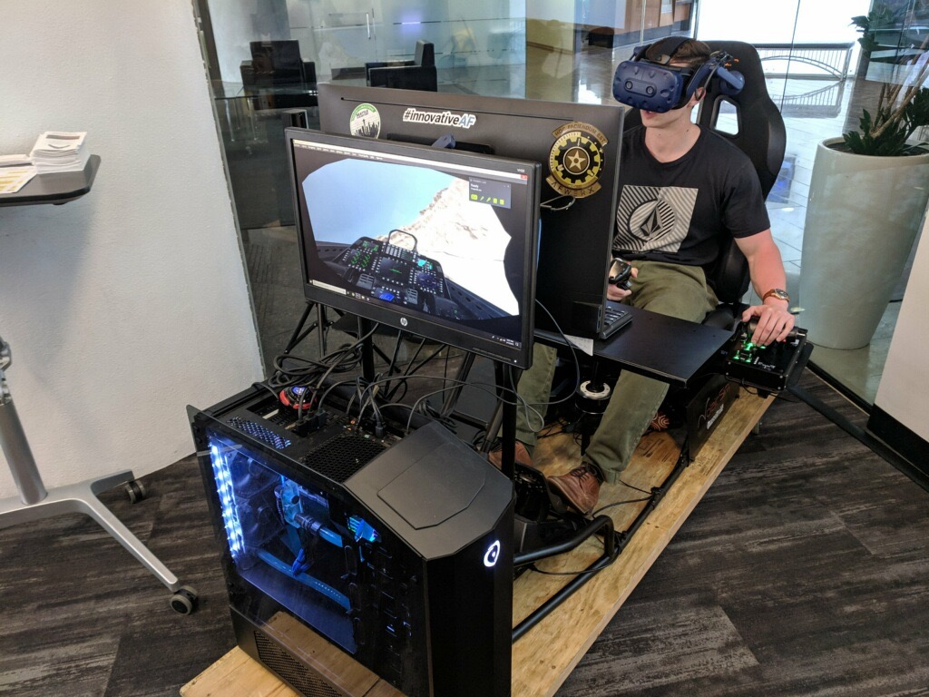
Research Sponsors
Pilot Training
NEXT
AFWERX Austin specializes in:
Integrating innovative technologies with Air Force programs
Augmented and Virtual Reality technologies for Airmen training
Rapid testing and evaluation with Air Force stakeholders
PTN is one of AETC’s forefront initiatives to improve UPT through immersive technology, 24/7 simulator availability, and a more student-tailored syllabi
Notes:
PTN emphasizes the use of virtual reality flight simulators along side periodic in-air flight experiences to make the pilot training process more efficient. As an effort to further the effectiveness of the program, PTN has teamed up with AFWERX to find and implement innovative solutions to program inefficiencies.
AFWERX acts as a strategic networking organization, providing the interface required for AF innovators to connect across industry, academia, and government.
PTN and AFWERX-Austin are the sponsors for the research I am presenting today. These organizations provided foundational objectives and data for this research.

Slide 5
AutoGradebook Concept
The AutoGradebook concept ties four separate lines of effort together into a single, user friendly software package:
Event recognition, grading, and real time feedback
Post-flight feedback and highlights
Automatic scheduling of subsequent flights
Next-flight event recommendations and planning :
No other existing tool for this
An automated system could lead to a more optimized syllabus by stacking maneuvers that enhance multiple competencies at once
Potential to save thousands of IP hours annually
Notes:
PTN has identified instructor pilot availability as an essential part of the training process. It is possible to generate more funding or manpower, but you can’t generate more time
In a joint effort to decrease the amount of time instructor pilots spend performing administrative work, the AutoGradebook Concept has come to light.
AutoGradebook refers to the concept of an automated software package that, if built, would perform some key instructor pilot duties.
Autogradebook still in conceptualization phase and prototypical components are designed to aid the IP decision making process. However, the end-game objective is to create a fully autonomous training evaluation and feedback tool.
LIST 4 COMPONENTS
Currently, Instructor pilots spend hours each day performing administrative tasks such as planning and scheduling flights.
Shows potential to make training plans more efficient and according to AFWERX projections, has potential to save 500+ IP hours per PTN class.
This component has not been developed yet. However, the prototype model being presented in todays research is the only existing model for next-flight event recommendation.
The conceptualization of next flight recommendation leads us to the objectives of this research.

Slide 6
Research Objectives
Devise and prototype algorithm that generates a set of flight event recommendations for an upcoming flight given student evaluation history.
Evaluate current PTN data collection and storage practices to make recommendations for improvement
Design a new metric to track student training progress more effectively than the current method.
Notes:
Routes back to the 4th component of the AutoGradebook concept.
Improvements primarily means create a suitable environment for the implementation of automated artificial intelligence and machine learning application, but also more standardized analysis moving forward.
Is the current method the best approach? Can we find a better metric?

Slide 7
Industry Leading Practices
Content-Based Filtering
Collaborative Filtering
Grouping items preferred by user with similar feature information to create preference profiles
Techniques: Bayesian classifiers, cluster analysis, decision trees and artificial neural networks
Relies on similarities between rating patterns of items rather than specific user behavior to make predictions
Techniques: Nearest Neighbor, Matrix Factorization
Recommender systems help suppress choice overload, the overwhelming feeling from being confronted with too many options to choose from. Two approaches to narrow choices:
Search Filtering: user already knows what they want
Data-Driven Recommendation: helps user decide (content-based vs. collaborative)
Notes:
Literature review focused on industry leading practices for recommendation rather than exploratory analysis techniques.
What are recommender systems? What do they do? How are they built?
As decision making becomes more and more complex, recommender systems help avoid or suppress choice overload. Recommender systems suggest a more selective set of choices for a user to make a decision
2 ways to narrow down options: Search filtering vs. data driven
----
CB identifies specific items that a user prefers to create a preference profile, then finds choices that match that profile.
Ex. Linked In recommending jobs for you based on skillsets or location
----------------------------------------------------------------------------------------------------------
Collab: identify similarities and patterns between users/items and make recommendations based on similarities.
Ex. Facebook recommending friends based on mutual friends
----------------------------------------------------------------------------------------------------------
These findings set the foundation for working with data to design a flight planning recommender system.

Slide 8
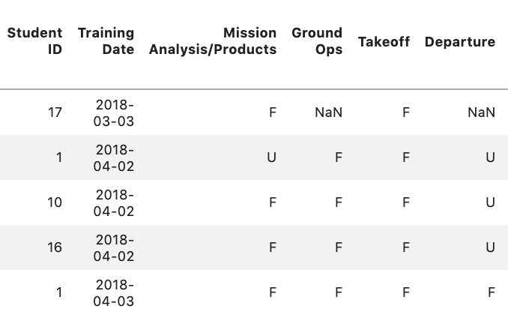
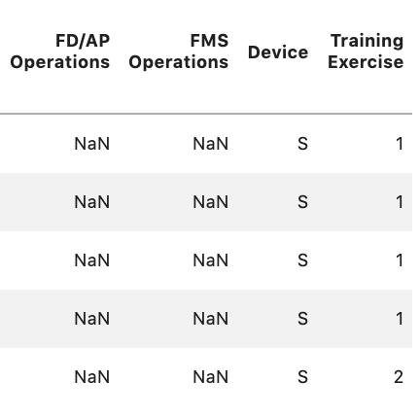
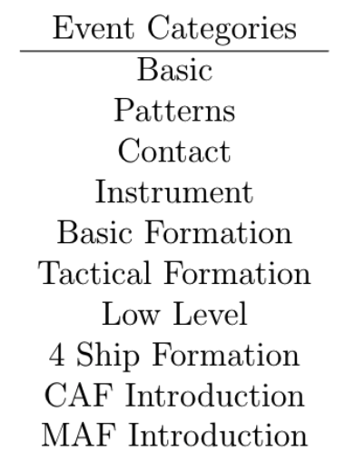
Data Description
PTN provided student grade sheets from original PTN class of 19 students.
*** 1 student’s data was omitted due to obvious failure to graduate ***
Grade sheet data includes:
Student identification number
Training exercise date
Student scores on graded events for each exercise
128 possible flight events
Each event falls into one of ten categories defined by PTN.
Device used for training (simulation or flight).
Notes:
PTN provided student grade sheets from original PTN class of 19 students.
A single student’s entire training program = training Campaign
Campaign composed of a series of training exercises.
Each training exercise consists of a set of flight events that students perform and receive graded evaluations on.
Grade sheet data includes:
Student identification number
Training exercise date
Student scores on graded events for each exercise
-128 possible flight events
-Each event falls into one of ten categories defined by PTN.
-Can receive scores of Unsatisfactory, Fair, Good, Excellent
Device used for training (simulation or flight).
Figures show examples of data and flight categories
*** 1 student’s data was omitted due to failure to graduate

Slide 9
Assumptions
The order of each individual student’s training exercises follow the order of the dates provided.
Any non-integer flight or simulation number in the data represents a flight cut short due to extenuating circumstances
Instructor pilot and student pilot time are the most important resource in the pilot training pipeline.
Notes:
Before working with the data, some assumptions needed to be made about PTN and the data provided. Shown here are a few of the key assumptions.
Each training exercise was numbered in the data. However, the numbering did not match the corresponding dates provided for each exercise. Therefore, the assumption was made that the dates provided the proper order of the training exercises.
The data also contained some non integer flight or simulation numbers. It was assumed that these records represented incomplete flights and were omitted from the data.
IP time is most valuable resource, so it is important to make a recommender system that works quickly.
Assumptions were developed in meetings with PTN and AFWERX or based on sparse data availability

Slide 10
Improving the Data Environment
Current Data
Suggested Improvement
Inconsistent temporal notation
Lacking specific data on time of flights and each maneuver within flight
Data Stored in improper formats (Dates, numbers, strings)
Ambiguous labeling / no data dictionary
Inconsistent manual data collection
Incomplete records
Lacking data on outside factors (weather, IP and aircraft availability, days off)
Ambiguous student performance metric
Improve temporal aspect of data collected
Time stamp training exercises
Implement stronger data formatting
Implement standardized data labels
Improved interface for data entry
Incorporate record confirmation components
Add outside data to support training data collected
Consider adoption of Future Progress Score metric
Notes:
Before any analysis was conducted, the data needed some cleaning and organization. During that initial data cleaning, plenty of suggestions for improving the data environment developed.
Three big ones:
Establishment of Data dictionary: further research/ work with this data could be conducted by a variety of people or organizations. Having an organized description of the data would help analysts or contractors familiarize themselves with the data, limit assumptions about the data, and keep various projects on the same wavelength
Improved Interface for Data Entry: Making data entry a selective process rather than manual entry from IPs would go a long way in standardizing the way data is collected and stored, greatly decreasing the amount of user error in data
Outside factors: Outside factors play a key roll in mission execution, so recording data on all factors that influence the mission is essential for the AutoGradebook concept

Slide 11
Exploratory Data Analysis
How personalized are training campaigns?
When are different flight events being evaluated?
How do students perform in each event throughout the duration of training?
Does the data show patterns in when events new events are being introduced?
How does performance over time compare between students?
Notes:
With a clean dataset, exploratory data analysis was conducted to familiarize myself with the data and provide insights on the current PTN program and how IPs make flight plans.
*MENTION + BRIEFLY EXPLAIN EACH ON LIST*

Slide 12
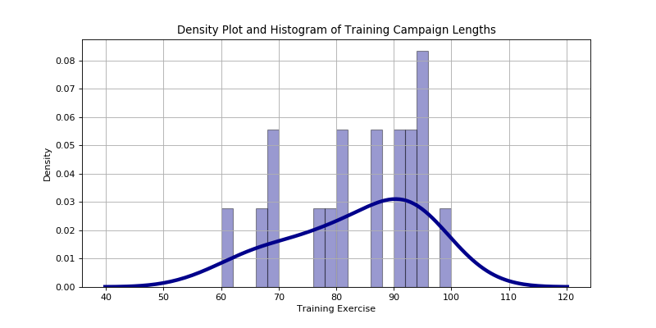
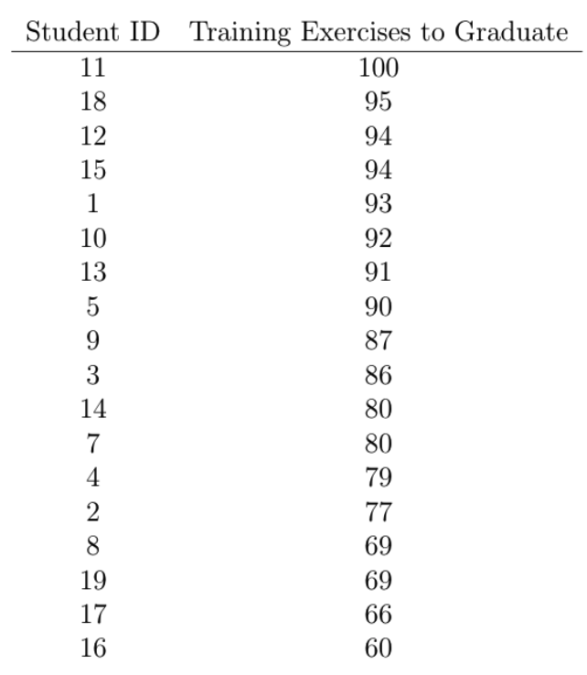
Campaign Variability
Personalization → variability
Campaign lengths
Ranged from 60 to 100 training exercises
Avg = 83, Median = 87, Mode = 88
Flight event exposure
There is a lot of variability in training campaign duration and flight event
exposure between students
Notes:
The data shows a left-skewed density distribution for overall training length.
Suggesting that students are less likely to finish training early.
histogram representing the percentage of students graduating on specific training days and a corresponding density curve to estimate what the probability of finishing training on a specific training exercise may look like given a larger dataset.
Variance in training length supports PTN claims to make pilot training more personalized to individual student training progress and performance.
Students that graduated with fewer total number of training exercises did not receive as much exposure to MAF and CAF events as those that took longer to graduate, indicating that individual student performance may not be the only driving factor determining when a student graduates.
Inconsistencies in expectation for which events are introduced between students' campaigns creates even more ambiguity to the necessary skill requirements and expectations for students to advance to the next phase of pilot training. Ambiguous graduation expectations may be leading to inconsistent performance of graduates.
Next, Trends in overall student progress and individual event performances were broken down to better understand the event recommendation process performed by IPs before each training exercise. NEXT SLIDE

Slide 13
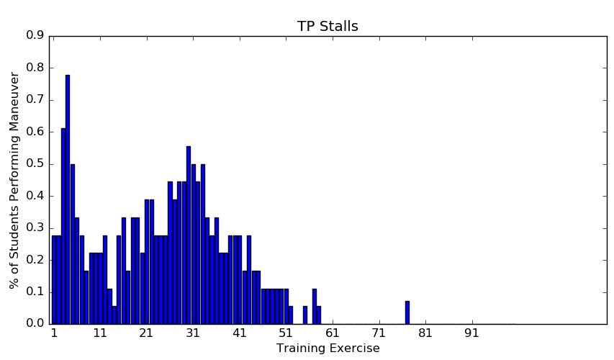
Event Occurrences
Event categories are not bound to strict timeline
Can target various competencies at once
Events within categories follow similar frequency trends
No pairing restrictions
Basic events are almost always evaluated
Contact and Instrument events are not equal focus of single exercises
Patterns performed along side all categories except low level
All MAF and CAF events were performed after training exercise 60
Notes:
Probability of each flight event being evaluated on any given training exercise. Only accounted for students still in training at specified training exercise.
No established pairing restrictions between events based on the flexibility of the PTN training program and training exercise structuring.
Contact and instrument events tended not to occur simultaneously.
Pattern events occurred with all other categories except low level events.
And, CAF and MAF events are all performed towards the end of training.
NEXT SLIDE

Slide 14
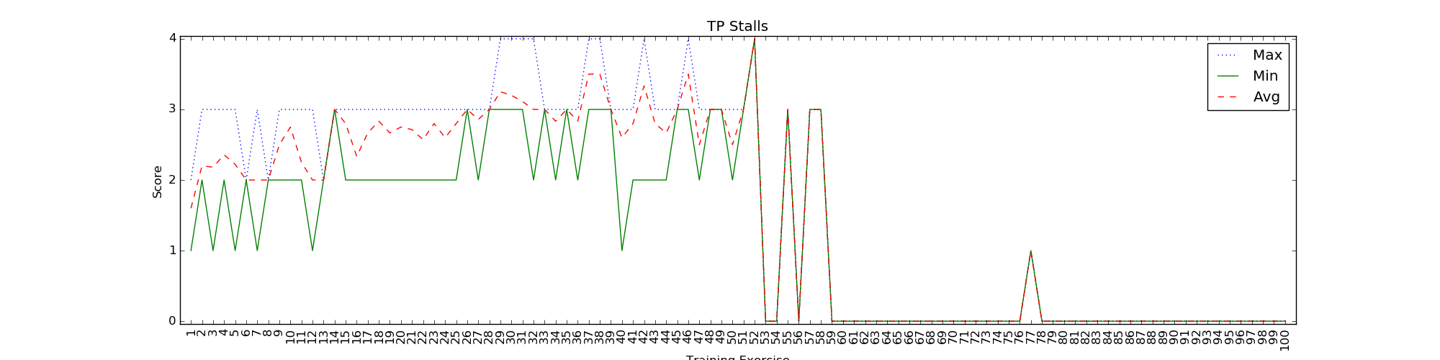
Event Performance
Maximum, average, and minimum score statistics for each training exercise were calculated for all events.
Only includes scores of students that performed equal to or greater than the specified number of training events.
Statistics for reaching proficiency in each graded event measured by training exercise stemmed from this data.
Notes:
Next, Performance statistics were also calculated to get a sense for what scores students were receiving on each numbered training exercise.
Stemming from this, descriptive statistics were recorded for how many training events it took for a student to be deemed proficient in each flight event
(Table 4 of research document)
General IP recommendation trends were also analyzed to get a sense of what recommendations should look like.

Slide 15
IP Recommendation Trends
No standardized order of introduction between events
IPs evaluate students using between 20 and 30 events on average each training exercise.
Number of new events and the number of events removed from the previous exercise tended to be similar
IPs might be performing 1-for-1 event swaps when create new flight plans for each training exercise
Notes:
No standardized order of introduction for events between students
IPs evaluate students using between 20 and 30 events on each training exercise.
Out of those events, about 25% of those are events that did not occur in the previous exercise
Only 3 or 4 of those tended not to occur in the previous 3 exercises
Number of new events and the number of events removed from the previous exercise tended to be similar
Indicating that IPs might be performing 1-for-1 event swaps when creating new flight plans for each training exercise
NEXT SLIDE

Slide 16
Overall Student Progress
Maneuver Item File (MIF)
Forward Progress Score (FPS)
Includes:
Depth of each individual flight event
Pros:
Simple
Already widely used
Cons:
Extremely ambiguous
Does not account for significance of different stages of progress
Difficult to gain insights from
Includes:
Depth of each individual flight event
Breadth of student knowledge across flight categories
Pros:
Captures multiple variables that go into student progress
Better displays student progress over time.
Cons:
More complicated calculation
Notes:
Hypothesizing that tracking a students training progress would be helpful information for making a recommender system that progresses a student through training, I decided to pick apart the current progress metric, known as the Maneuver Item File.
MIF is essentially a cumulative sum of the best scores a student has earned on each flight event at a given point in training.
*TALK ABOUT MIF SIDE*
The ambiguity and shortcomings of the MIF led to the development of the Forward Progress Score.
*TALK ABOUT FPS SIDE*

Slide 17
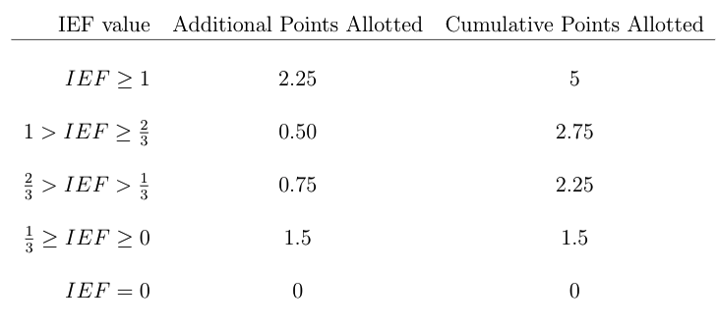
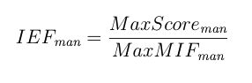
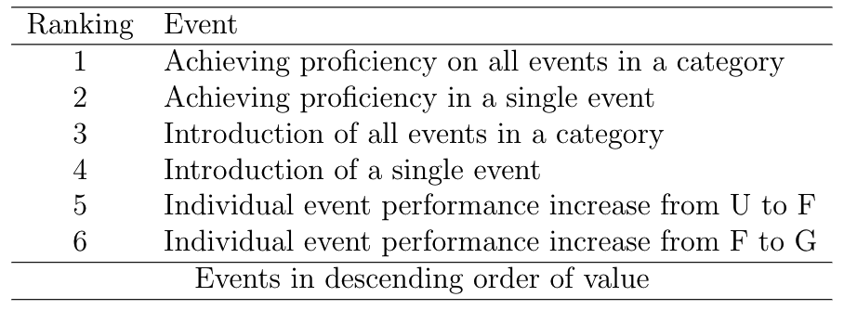
FPS Formulation
Hierarchical point system accounting for student progress:
Individual event progression (depth)
Introduction to new event categories (breadth)
Proven proficiency in event categories (depth + breadth)
#1 uses Individual Event Fraction
to determine progress
#2 and #3 both receive 6 points
upon completion
Notes:
The FPS is calculated using a hierarchical point system, incorporating three components of student progression to more precisely express student advancement through training. The three components of student progression determining the FPS include individual event scores, introduction to new event categories, and proven proficiency in event categories.
Event progression is represented using individual event fractions, which are the percentage towards proficiency that a student is at for any given flight event. For each event, students accumulate points based on their individual event fraction value. The point allocation breakdown is shown on the right.
Introduction to an entire category and proving proficiency in an entire category both receive 6 points upon completion. The reward of 6 points was chosen to establish a preference for event recommendation based on the preference table in the bottom right.
This is essential when making flight plan recommendations because if a student has the opportunity to be familiarized with, or become proficient in every event within a flight category, then recommending an event that does this should be prioritized over recommending an event that does not.

Slide 18
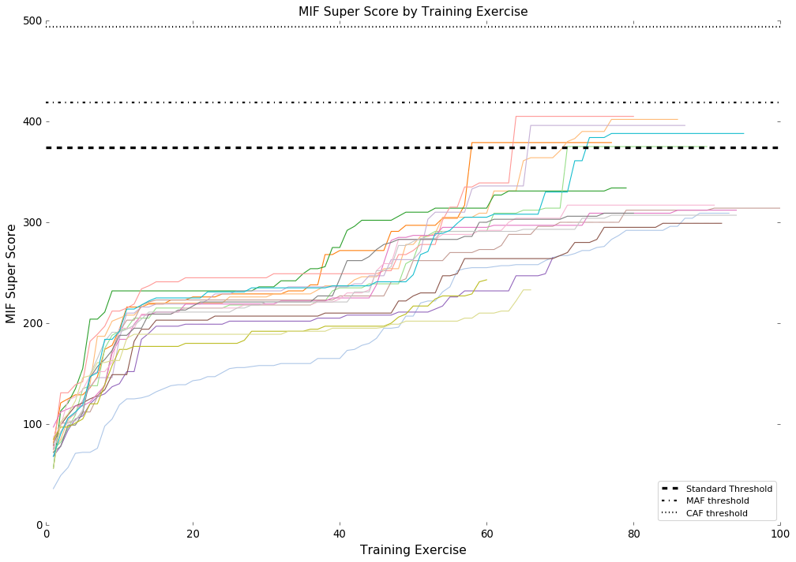
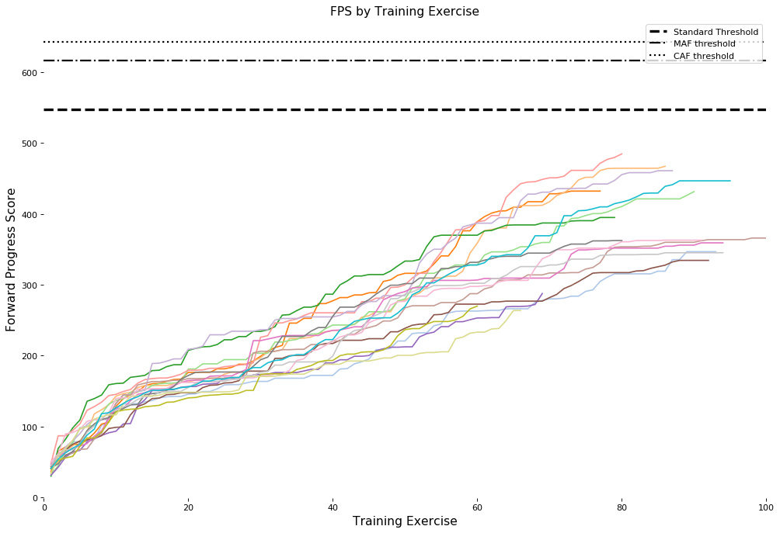
MIF vs FPS
FPS captures breadth and depth of student training better than cumulative MIF
Notes:
Left plot shows Cumulative MIF score over time for each student. Right plot shows FPS over time for each student.
Dashed lines correspond to the scores that a student would have when full proficiency in all flight events.
Scales are different because the point system for reaching proficiency is different between methods, but concept behind figures is same.
Using a hierarchical point system allows FPS to capture the significance of increasing event scores and of making progress on entire categories of competency. Accounting for the different levels of progress allows for more informed decision making to improve student progress when planning flights
NEXT SLIDE

Slide 19
Hybrid Model Motivation
Content-Based Filtering
Collaborative Filtering
Pros:
Personalized training paths
Fewer educational gaps
Limit unnecessary training
Cons:
Failure to progress
Deviation from primary mission
Pros:
Introduces competitive aspect
Standardized performance expectations
Aligns campaign with PTN mission
Cons:
Not specified to user’s preferences
Hybrid Filtering
No model is perfect, but some are useful
Combining various model results helps address a problem from multiple angles
Hybrid filtering allows for personalized recommendations that guide students towards a common training performance standard
Notes:
After developing a solid grasp on the flight planning process, I began designing recommender system. Earlier I described content based and collaborative filtering in a general context. Now I am going to touch on how they both apply to flight event recommendation.
Don’t want to be too personalized- can slow us down. Add in collaborative model that accounts for overall student population expectations
No single model we build is going to be perfect, but by combining various modelling approaches we can address the task from multiple perspectives and get a better suited recommendation for the user.
For the event recommendation task, hybrid filtering allows for personalized event recommendations based on individual student performance while also guiding performance towards or beyond training expectations.

Slide 20
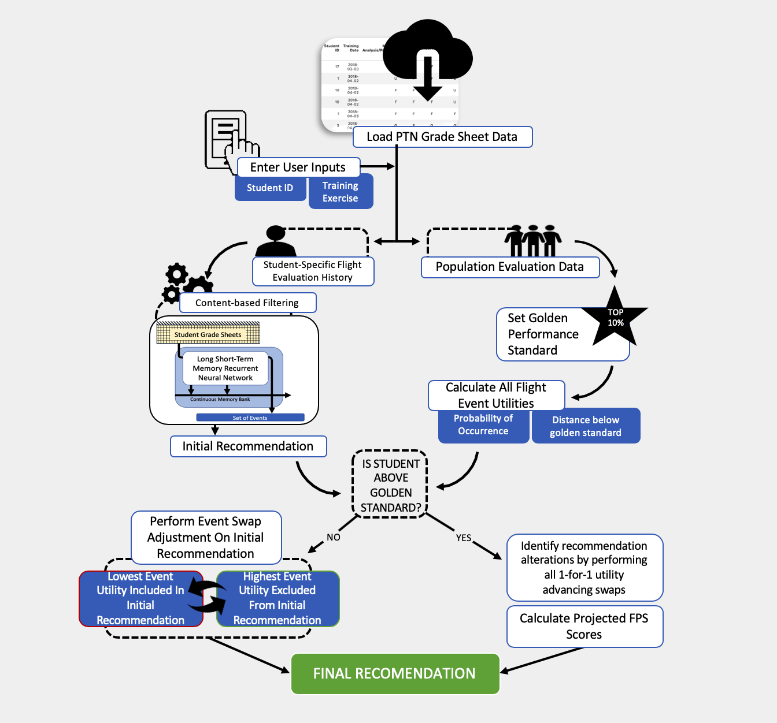
Modeling Approach
Notes:
This is what the model is going to do.

Slide 21
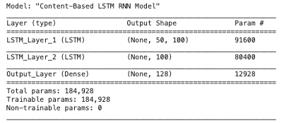
Content-Based Model Architecture
Two layer stacked Long Short-Term Memory Recurrent Neural Network
LSTM layers: Rectified linear unit (ReLU) activation functions
Non linear activation functions help capture complexity of data and address vanishing gradient problem.
Output layer: Sigmoid activation function
Pushes all predicted values towards 0 or 1 for binary classification purposes
Notes:
Vanishing gradient: in model training, weights are being adjusted from the last layer to the first layer by finding derivatives. This is called backpropogation. Multiplication occurs occurs in that process and if we start multiplying small numbers by small numbers, we keep getting smaller and smaller gradients.
Meaning that the weights and biases of the initial layers will not be updated effectively with each training session. Since these initial layers are often crucial to recognizing the core elements of the input data, it can lead to overall inaccuracy of the whole network.
Model contains about 185,000 parameters

Slide 22
Content-Based Data Preparation
Inputs: Student scores recorded as percentages of the individual event MIF required for proficiency
Model input sequence lengths of 10, 25, and 50
Most recent training exercise evaluations included
Restructured as three dimensional arrays with a designated sequence length number of training exercise evaluations
All missing sets were forward padded with sets of 0 values representing training exercises with no flight event evaluations.
Target Variables: Single set of flight events that the model compares results with during training to make parameter adjustments
Targets formatted as vectors with binary representations of event occurrence
Gathered from the succeeding training event of the input sequence
Notes:
In order to input data into an LSTM model, data has to be structured in a very specific way.
The model inputs consist of student scores recorded as percentages of the proficiency. Inputting scores as a percentage of proficiency normalizes the values, allowing for more efficient parameter training
.
Model input sequence lengths of 10, 25, and 50 were explored for model performance purposes.
All input sequences must be the same size when training a model. All missing sets were forward padded with sets of 0 values representing training exercises with no flight event evaluations.
Forward padding the inputs enables model training for a variety of evaluation history lengths while maintaining consistent input size.
Only the most recent training exercise evaluations were included in the input if the input correlated to a training exercise recommendation beyond the designated sequence lengths.
Target variable sets were also restructured to create an appropriate training and testing environment for the model. The training targets, referring to the single set of flight events that the model compares results with during training to make parameter adjustments, were gathered from the succeeding training exercise of the input sequence. The training targets were reformatted from student grades to binary representations of event occurrence.

Slide 23
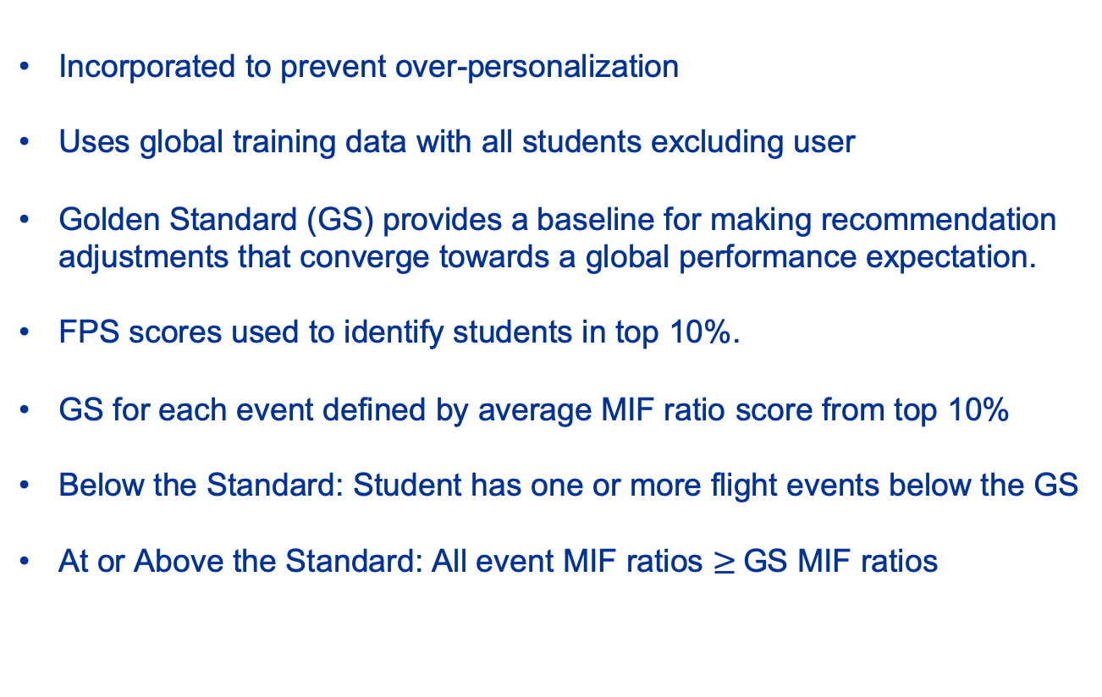
Collaborative Model
Incorporated to prevent over-personalization
Uses global training data with all students excluding user
Golden Standard (GS) provides a baseline for making recommendation adjustments that converge towards a global performance expectation.
FPS scores used to identify students in top 10%.
GS for each event defined by average MIF ratio score from top 10%
Below the Standard: Student has one or more flight events below the GS
At or Above the Standard: All event MIF ratios $≥$GS MIF ratios
Notes:
Incorporated to prevent over personalization and progress stagnation
Uses a Golden Standard (GS) defined by top 10% of student performances to provide a baseline for making recommendation adjustments that converge towards a global performance expectation.
Students below the standard are guided towards it
Students above the standard are guided towards a higher projected forward progress score

Slide 24

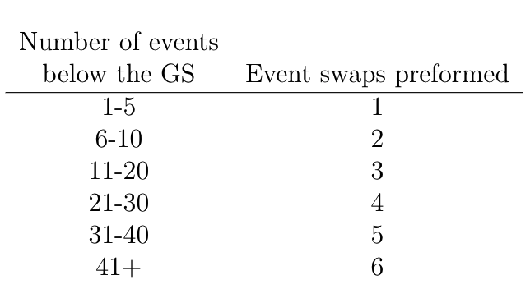
Event Swapping
Content-Based Recommendation
Below Golden Standard
At or Above Golden Standard
Identify event from content-based recommendation with lowest utility
Identify event excluded from content-based recommendation with highest utility
Make 1-for-1 swaps accordingly
Golden
Standard
Create list of alternative recommendations from 1-for-1 utility advancing swaps
Calculate projected FPS on next exercise for content-based and alternative recommendations
Set of events projecting highest FPS for next event used as final recommendation
Tie breakers decided randomly
Final Recommendation
Notes:
The event swapping mechanism is the key component of the collaborative model.
A utility value for the recommendation of each event on the specified training exercise is calculated.
Below: events within the content-based recommendation with the lowest utility are swapped with the events excluded from the content-based recommendation yielding the highest utility. The number of 1-for-1 swaps conducted aligns with the table on the left.
Above: list of alternative recommendations based on 1-for-1 utility advancing swaps is created. The set of flight events that is projected to increase the students FPS the most is used as the final recommendation.

Slide 25
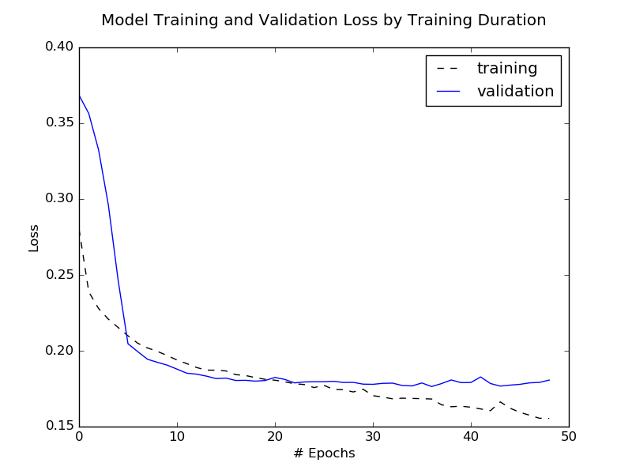
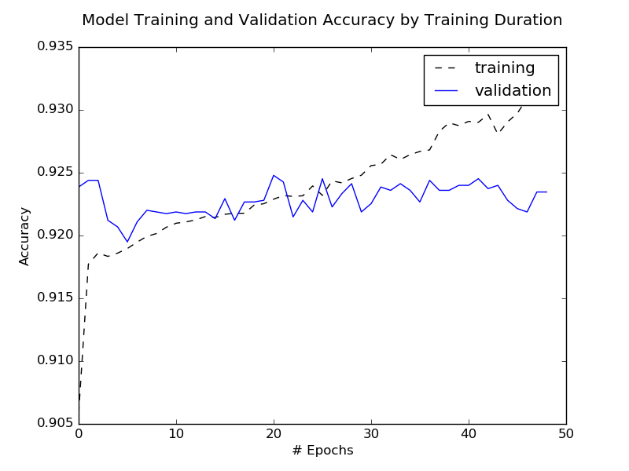
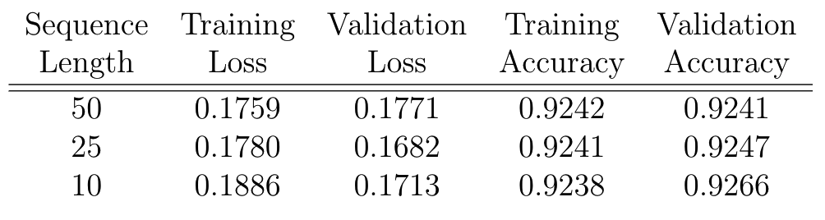
Model Training & Validation
Training and validation only conducted on content-based model
14/18 students used in training set
Performance measured by classification accuracy (maximize) and binary cross-entropy (minimize) loss
Leave-One-Out Cross Validation
3 inputs lengths evaluated, 14 models each
Focus on binary cross-entropy loss
Train for 100 epochs applying early stopping
loss delta = .001 with early stopping after 15 epochs
Sequence input length had limited influence on model performance,
likely due to sparse data
Notes:
The last step of model design was to train the parameters within the content-based model. The collaborative model has a specific purpose to improve recommendation so it was unnecessary to include it in the model training.
Slide
Performance of the model was measured using binary cross-entropy loss and classification accuracy.

Slide 26
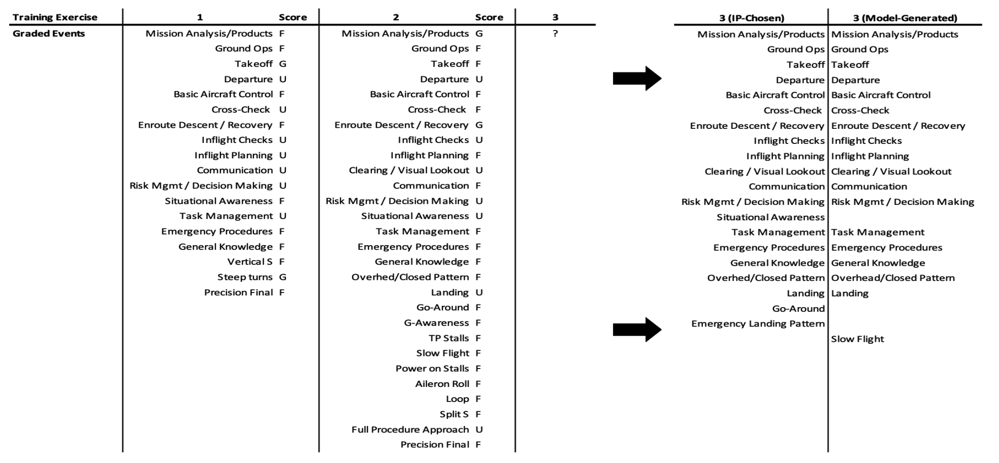
Recommendation Comparison
Sequential temporal evaluation data is used to make predictions on what flight events should be evaluated in a student’s next exercise.
Notes:
Here is an example case of the evaluation history and resulting recommendations from an instructor pilot side-by-side with the final recommendation from the hybrid filtering model.

Slide 27
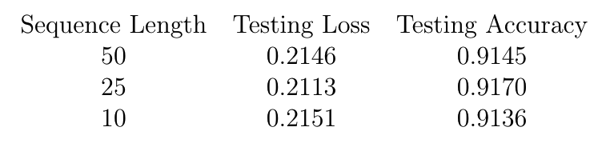
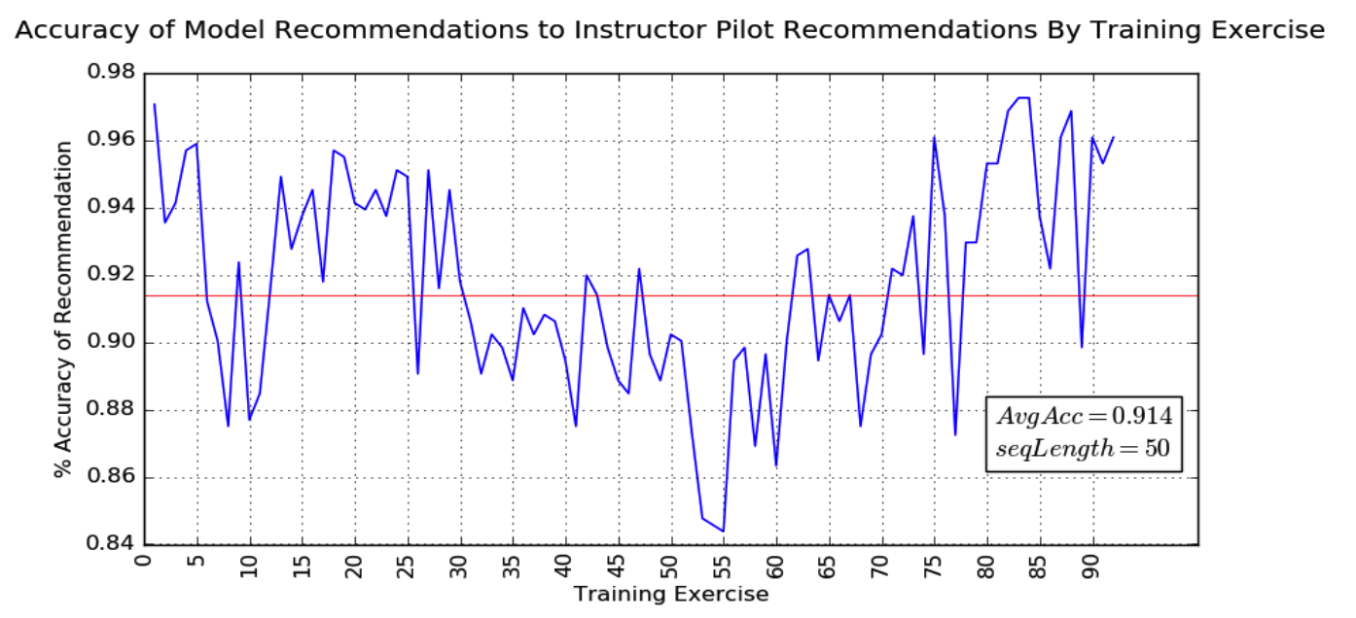
Testing
.
Model performance is not consistent across training campaign duration,
implying inconsistent student personalization
Notes:
For testing, Model recommendations were compared to actual flight plans that IPs created to measure binary cross entropy and accuracy.
The data used for testing came from the 4 students excluded from the training set. 331 recommendations were tested using the 3 different lengths of training input data.
Testing showed that input sequence length did not make much of a difference on performance metrics
Went with sequence length of 50 because some students hit events early on and then didn’t revisit until way later in their training campaign. This allows the model to recognize that the student has seen events before, even if they saw them a fairly long time ago.
Also looked at accuracy with respect to numbered training exercises.
Avg accuracy was about 92% but this chart shows that model performance is not consistent throughout a training campaign, suggesting that there are inconsistencies in the amount of personalization between each students training plans.

Slide 28
Time Trials
Recommendation time was recorded for 331 individual recommendations generated using the full hybrid model
Average recommendation time of 8.14 seconds
Slowest time of 10.05 seconds
Recommendations are generated in only 8 seconds.
Notes:
Given the importance of planning time, the last analysis performed in this research was on the time required for the model to generate a flight plan.
READ SLIDE HERE
Leads us into overall research contributions.

Slide 29
Contributions
First existing model for flight event recommendations
Flight planning time reduced to seconds, allowing IP time reallocation to personalized student development. Potential to save 500+ hours per PTN class
Applications of automated planning go beyond PTN
Other Formal Training Units
Provide competent training guidance in non-AETC training environments
Help create efficient flight profiles for operational Air Force needs
Development of new training progress metric allows for unambiguous performance tracking and comparison between pilot training students.
Notes:
The developed prototype recommender system is the first existing model for next-flight event plan recommendations
Using limited data, this research provided a proof of concept that it is possible to use statistical machine learning models to generate a reasonable set of flight events for a student’s next training exercise.
The applications of this go beyond PTN:
Training perspective: Applications of automated training recommendations can be applied to other formal training units for RPA pilots, combat systems officers, or air battle managers.
Also, shows plausibility of providing competent training guidance in non-AETC training environments such USAFA or ROTC detachments, establishing foundational experience before official enrollment in UPT. If students show up to undergraduate pilot training already familiar with flight competencies, this may lead to less formalized training required to reach graduation qualification, thus indirectly shortening the amount of time it takes to graduate new pilots.
Operational: In the operational world, pilot are required to maintain flight experience. Similarly designed recommender systems may be able to help create efficient, required flight profiles for various categories of pilots and training needs, leading to excessive savings on fuel and maintenance costs.
Lastly, development of the forward progress score metric allows for unambiguous performance tracking and comparison between pilot training students.

Slide 30
Future Work
Reinforcement Learning Component
Content-Based Model Tuning and Alternatives
Improvements to Event Utility Calculations
Incorporation of probability of progress into event utilities
Incorporation of expected event performances before proficiency

Slide 31

Instructor Pilot Inputs
Students are tracked by a student ID
Each grade sheet input corresponds to an individual training exercise
Training exercises are numbered. Recommendations are for the next training exercise of the student’s training campaign
Student ID
Exercise #
The user is only required to provide student ID and the upcoming exercise number that they intent to receive flight recommendations for.
Notes:
Here, I have an example of the working prototype.
It requires minimal inputs from the user, only the student-specific user identification number, and the numbered training exercise that the flight plan will be generated for.

Slide 32
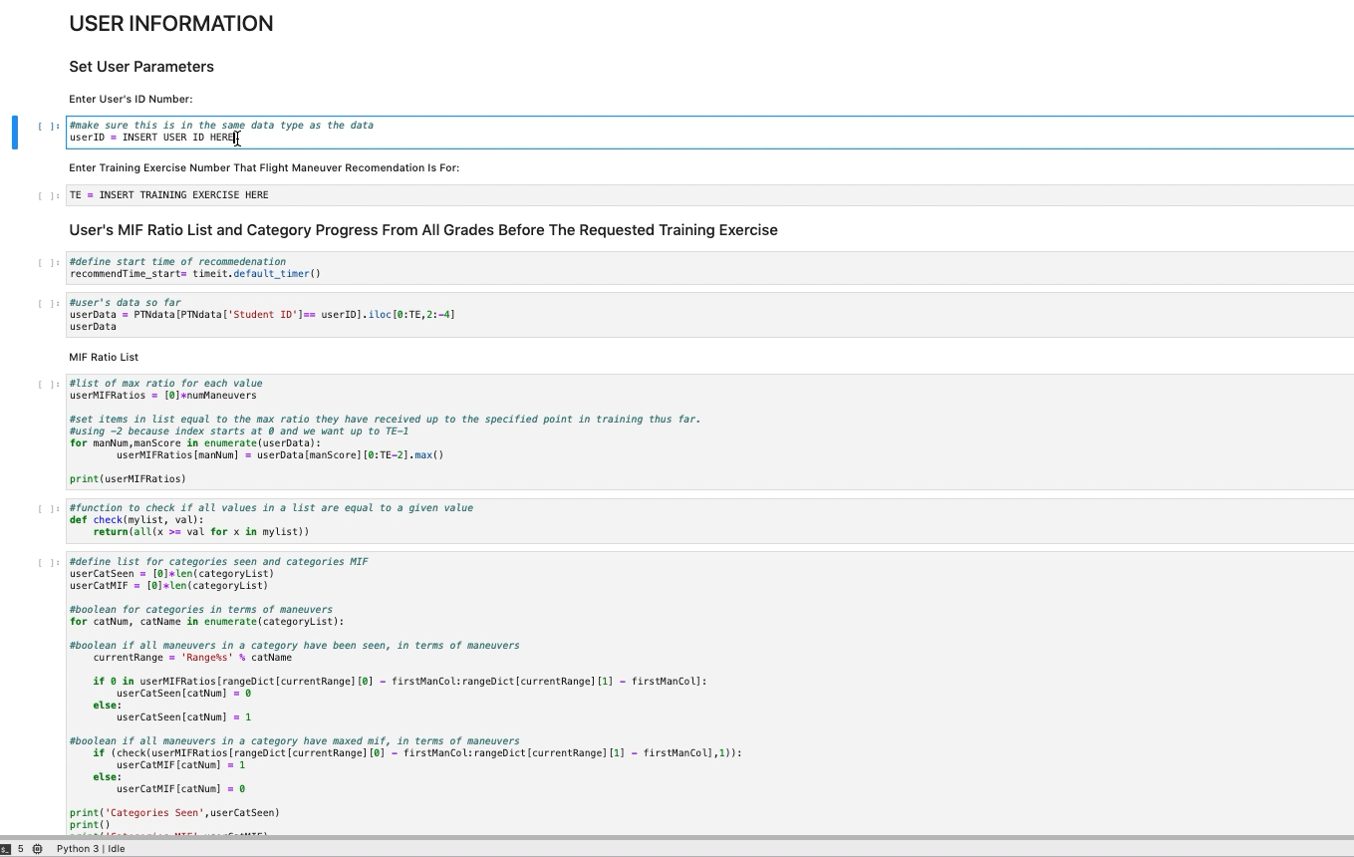
Prototype Example
Notes:
In its prototypical form here, I am requesting a training plan for Student 3’s 55th training exercise. As you can see there is a lot of code and there are a lot of real time calculations being performed under the hood. But in only 8 seconds, a full set of recommended flight events is generated.

Slide 33
Recommendation Example
The following 31 training events are recommended on training exercise 55 for the student with ID: 3
Graded Events (31) |  |  | Event Category
Mission Analysis/Products Ground Ops Takeoff Basic Aircraft Control Cross-Check | Enroute Descent / Recovery Inflight Checks Inflight Planning Clearing / Visual Lookout Communication | Risk Mgmt / Decision Making Situational Awareness Task Management Emergency Procedures General Knowledge | Basic (15)
Overhead/Closed Pattern | Landing |  | Pattern (2)
Non-Precision Final |  |  | Instrument (1)
G-Warmup / Awareness Fingertip (Wing) | Straight Ahead Rejoin Turning Rejoin | Position Change Flt Integrity / Wingman Consideration | Basic Formation (6)
Delay 90 Delay 45 | Hook turn Shackle | Cross turn | Tactical Formation (5)
Course Mx | LL GPS Integration |  | Low Level (2)
Final recommendations are presented as a set of flight events to be evaluated by
an Instructor Pilot on the student’s next training exercise.
Notes:
Cleaning up the recommender system’s output into a more user friendly interface leads us to something that looks like this.
Final recommendations are presented as a set of flight events to be evaluated by an instructor pilot on the students next training exercise.
On the left, we have all of the recommended flight events. On the right are their corresponding flight categories.
We can see 35% of the recommended events are from the formation categories, indicating the primary focus of this flight example.

Slide 34
Conclusions
Gathered significant insights from sparse data
Room for data improvements and program standardization.
Proof of concept
Plenty of future work in recommendation improvement and integration
Notes:
In conclusion,
We were able to take very limited data from the start of a new Air Force program to:
Display insights on pilot training next performance trends
Suggest recommendations to improve future data collection and storage
And prove that it is possible to use deep learning and applied statistics to make flight planning recommendations.
Also, despite all of the work presented today, there is still plenty of future work for recommendation improvements and implementation

Slide 35
Overview
Background and Introduction
Research Objectives
Data and Recommendations
Exploratory Data Analysis
Student Performance Metrics
Modeling Approach
Model Results and Analysis
Contributions
Future Work
Demo

Slide 36
Questions?

Slide 37
Back Up Slides

Slide 38
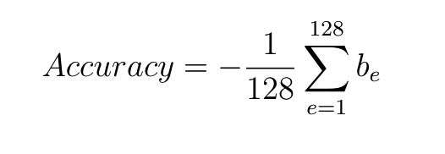
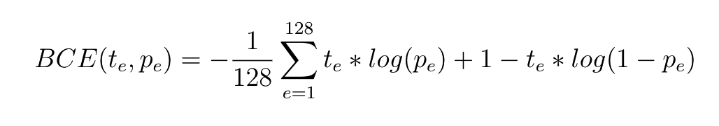
Acc and BCE equations

Slide 39
Add # training excercises until expected proficiency into utility calculation
-this info was already looked at by a previous study.

Slide 40
AutoGradebook Concept
The AutoGradebook concept ties four separate lines of effort together into a single, user friendly software package:
Event recognition, grading, and real time feedback
Post-flight feedback and highlights
Automatic scheduling of subsequent flights
Next-flight event recommendations and planning :
Creating an automated system could lead to a more optimized syllabus by stacking maneuvers that enhance multiple competencies at once
Drastically reduce instructor pilot time spent performing administrative tasks - 20 min reduction in flight plan time → 26 hrs/student per PTN class
- 26 hrs per student → 500+ saved IP hrs per PTN class
- Potential to save thousands of IP hours annually.
Notes:
PTN has identified instructor pilot availability as an essential part of the training process. It is possible to generate more funding or manpower, but you cant generate more time
In a joint effort to decrease the amount of time instructor pilots spend performing administrative work, the AutoGradebook Concept has come to light.
AutoGradebook refers to an automated software package that can perform some duties of instructor pilots. (4 duties listed)
Autogradebook still in conceptualization phase and prototypical components are designed to aid the IP decision making process. However, the end-game objective is to create a fully autonomous training evaluation and feedback tool.
Instructor pilots spend hours each day performing administrative tasks such as planning and scheduling flights.
INTRODUCE RECOMMENDER SYSTEM RESEARCH FOCUS

Slide 41
Time Trials
Recommendation time was recorded for 331 individual recommendations generated using the full hybrid model
Average recommendation time of 8.14 seconds with a standard deviation of 0.10 seconds.
Median time = 8.04 secs
Minimum time = 7.93 secs
Maximum time = 10.05 seconds.
Recommendations are generated in only 8 seconds.
Notes:
Leads us into overall research contributions.

